Slide 1
Data Analysis Of Singapore’s
Waste Management
Yadanar Aung (P2214621)
DAAA/FT/1B/02
ST1510 PDAS

Slide 2
Table of Contents
01
02
Nature of Datasets
Data Cleaning & Wrangling
03
Data Visualization & Insights

Slide 3
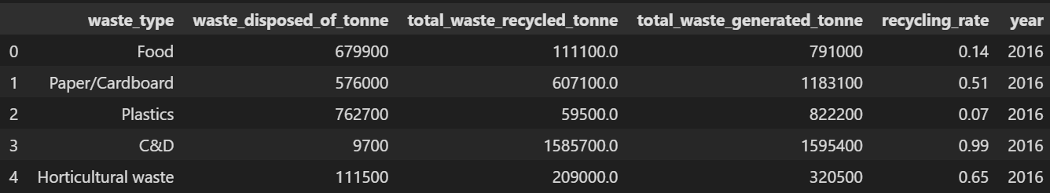
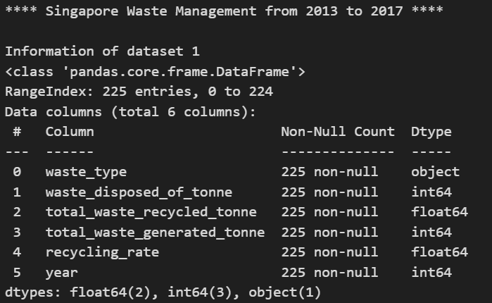
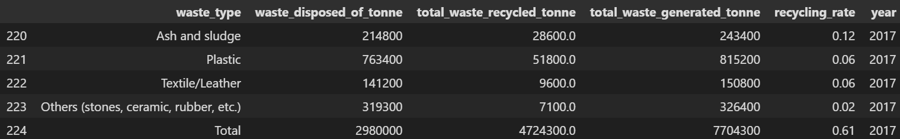
Nature of Dataset 1
2003_2017_waste.csv
https://www.kaggle.com/datasets/mahaanand/singapore-waster-mgmt?select=2003_2017_waste.csv
First 5 Rows:
Information of Dataset 1:
Last 5 Rows:

Slide 4
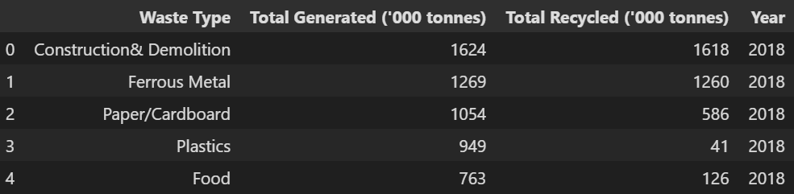
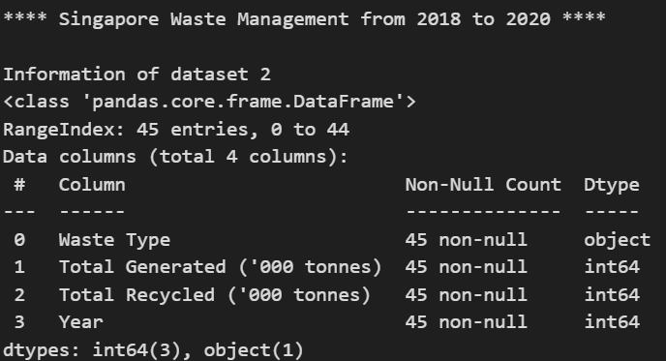
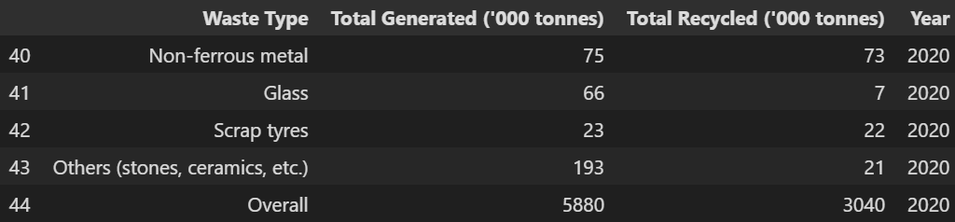
Nature of Dataset 2
2018_2020_waste.csv
First 5 Rows:
https://www.kaggle.com/datasets/mahaanand/singapore-waster-mgmt?select=2018_2020_waste.csv
Information of Dataset 2:
Last 5 Rows:

Slide 5
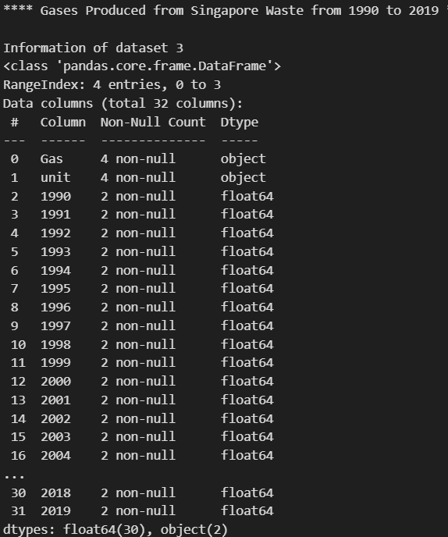
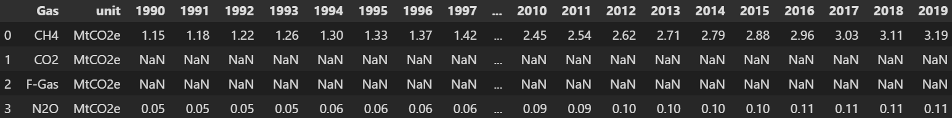
Nature of Dataset 3
ghg-emissions.csv
https://www.climatewatchdata.org/ghg-emissions?breakBy=gas&end_year=2019&gases=all-ghg&regions=SGP&sectors=waste&start_year=1990
Information of Dataset 3:

Slide 6
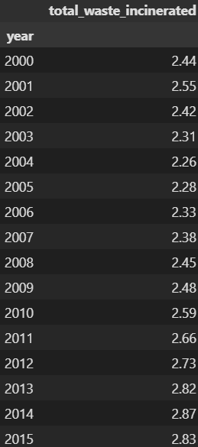
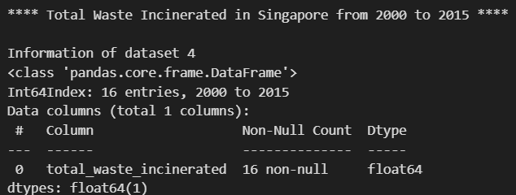
Nature of Dataset 4
solid-waste-management-total-waste-incinerated.csv
https://data.gov.sg/dataset/solid-waste-management-total-waste-incinerated-annual?view_id=882ae208-bd25-4b99-8cc9-a3b7b24d063a&resource_id=e4c8461f-e7de-4fc3-ad25-cf068ae09509
Information of Dataset 4:

Slide 7
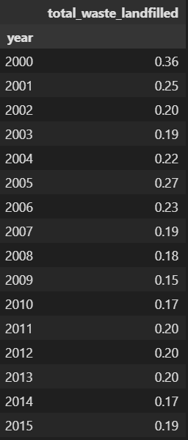
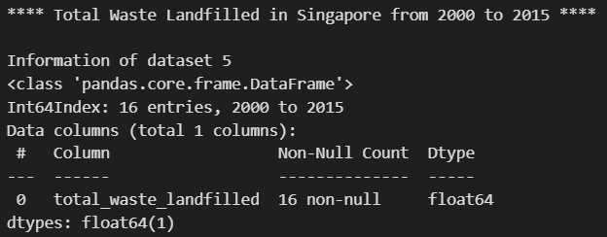
Nature of Dataset 5
solid-waste-management-total-waste-landfilled.csv
hhttps://data.gov.sg/dataset/solid-waste-management-total-waste-landfilled-annual?view_id=c89734bc-5081-4730-be0e-83f2f59ab735&resource_id=81292d12-57a5-4e76-a65b-effacc6806b7
Information of Dataset 5:

Slide 8
Datasets 1 & 2 Cleaning
Dataset 1 :
Datasets 1 & 2 are related to Waste Management across the years & have common columns.
Hence, we will be cleaning the datasets with the intention to concatenate them afterwards
Dataset 2 :

Slide 9
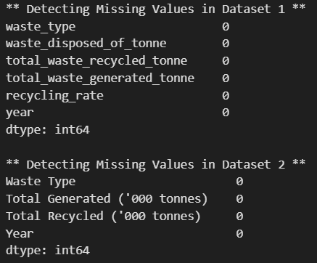
Check for Missing Values
Pandas function used:
isnull().sum()
There are no missing values, but we will check again after concatenating the datasets

Slide 10
Check if Values are Represented Consistently
Dataset 1 :
Dataset 2 :

Slide 11
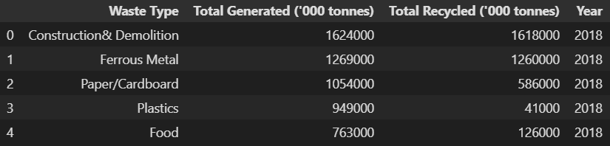
Correct Values Under ‘Total Generated’ & ‘Total Recycled’ In Dataset 2

Slide 12
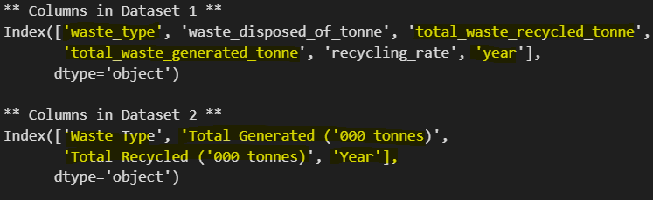
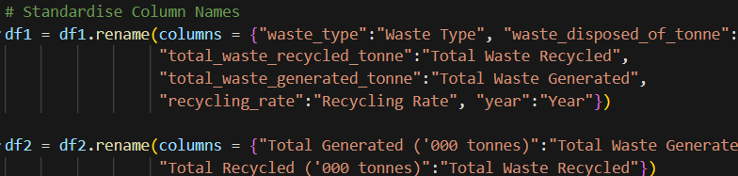
Standardise Column Names
Pandas function used:
.rename()

Slide 13


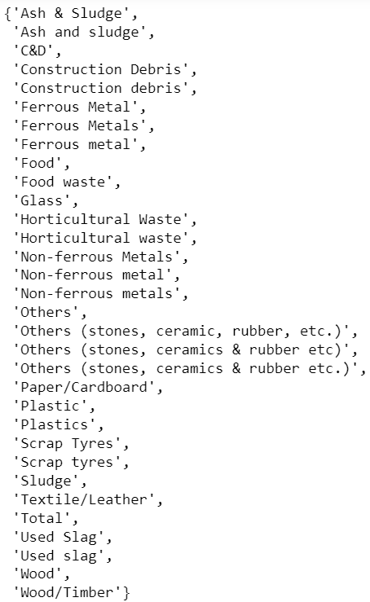
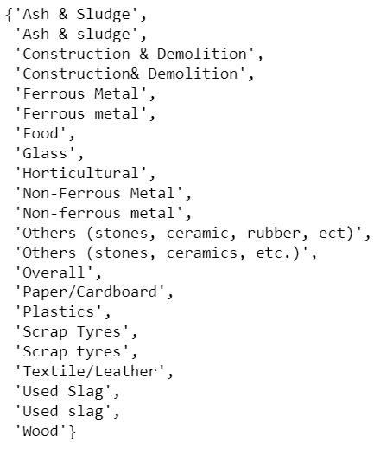

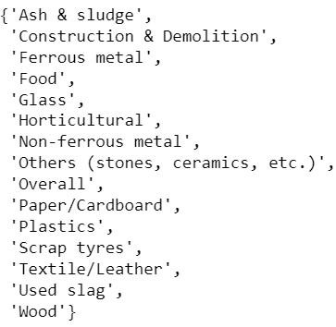
Check Unique Column Values In Each Dataset
Expect No. of Unique Values:
Pandas function used:
.unique()

Slide 14
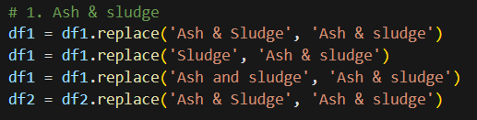
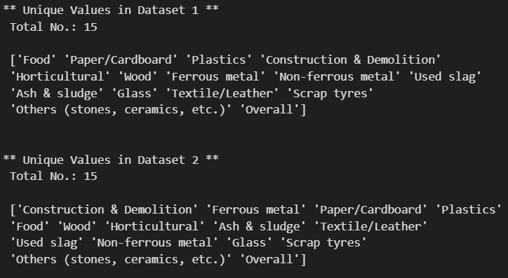
Standardise Column Values Under ‘Waste Type’
Pandas function used:
.replace()
After Standardising:

Slide 15
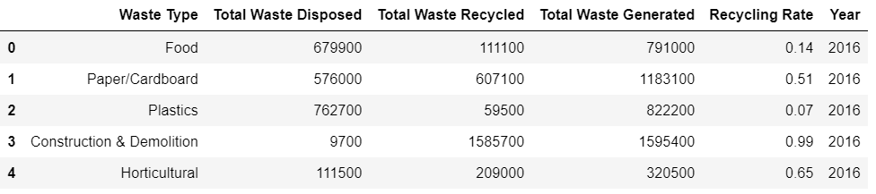
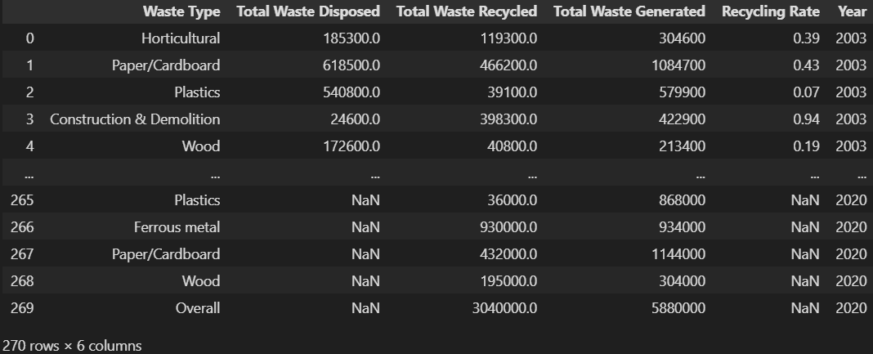
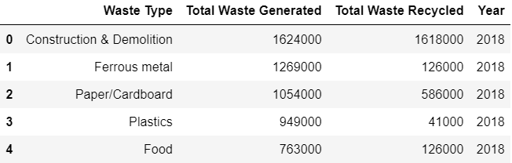
Concatenate Dataset 1 & 2
Dataset 1 :
After concatenating:
Dataset 2 :

Slide 16
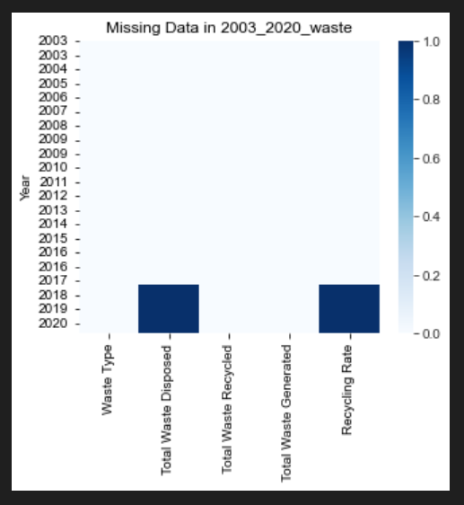
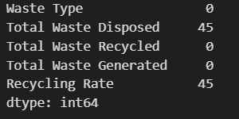
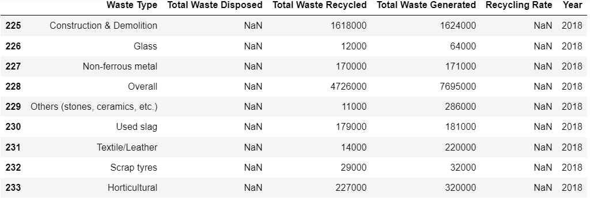
Check for Missing Value
Pandas function used:
.isnull().sum()

Slide 17
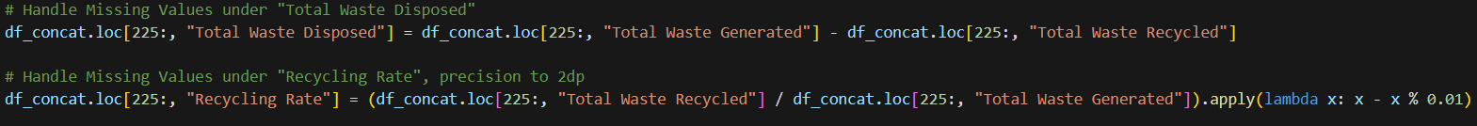
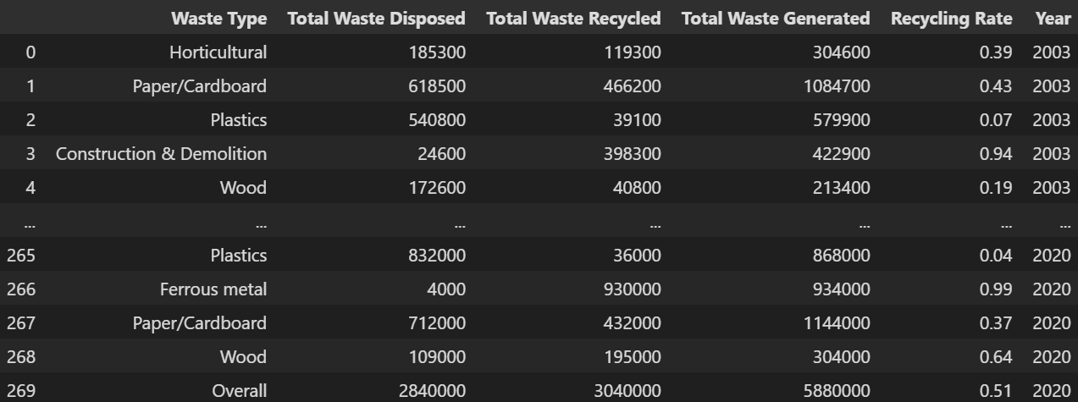
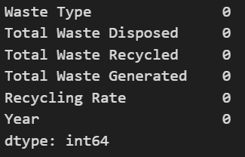
Handle Missing Value

Slide 18
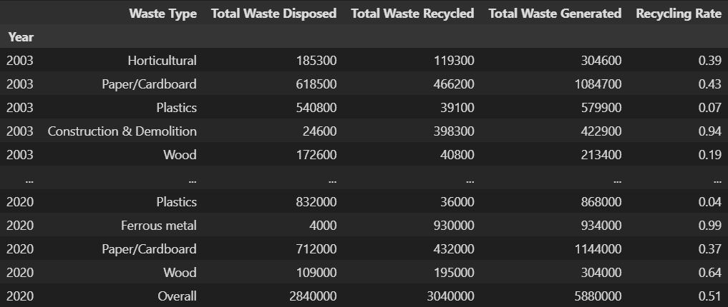

Final Cleaned Dataset 1 & 2
Save to New File:

Slide 19
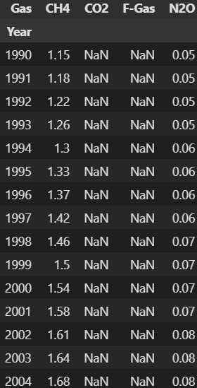
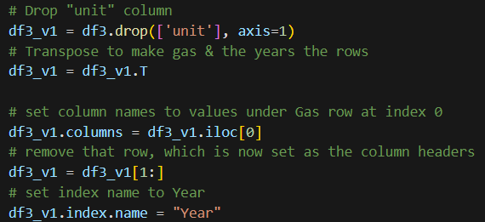
Dataset 3 Cleaning
After reshaping:
Before:
Reshaping Dataset:

Slide 20
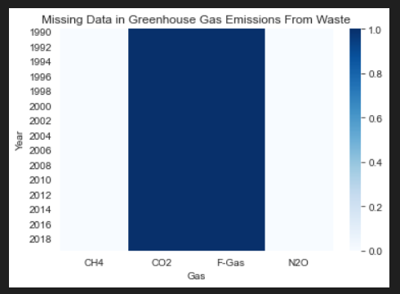
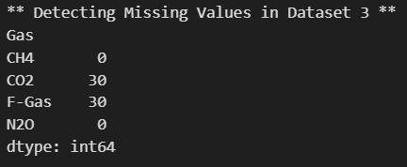
Check for Missing Values
Pandas function used:
isnull().sum()

Slide 21
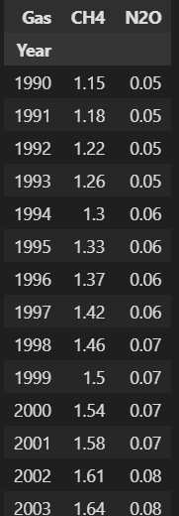
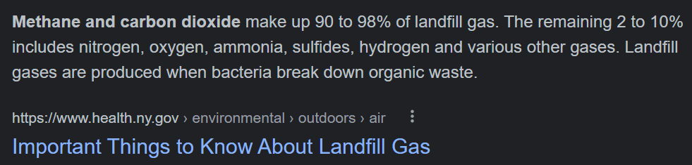
Handle Missing Value
After dropping the columns:
According to Health New York State:
Drop columns ‘CO2’ & ‘F-Gas’
Methane(CH4) & Nitrous Oxide(N20) are the more significant greenhouse gases produced from waste

Slide 22
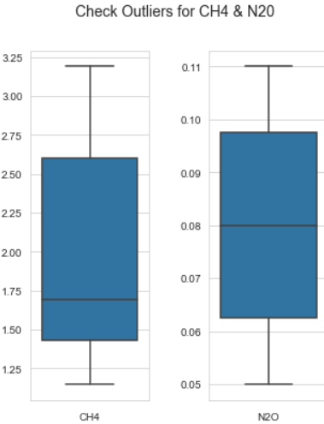
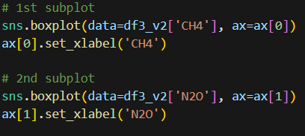
Check for Outliers Using BoxPlot

Slide 23
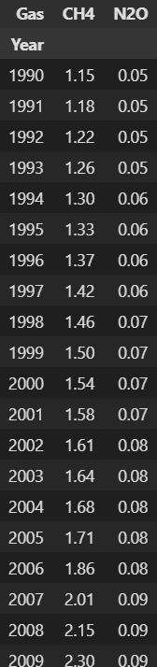
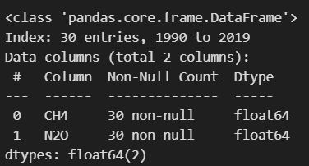
Final Cleaned Dataset 3
Nature of Dataset:
Save to New File:

Slide 24
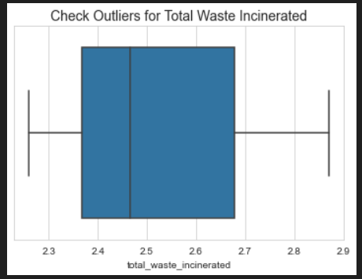

Dataset 4 Cleaning
Checking for Outliers:
Checking for Missing Values:
isnull().sum()
No outlier

Slide 25
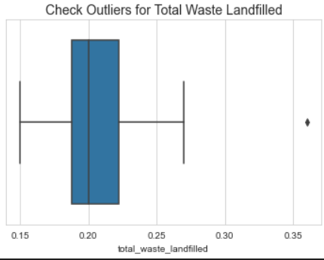

Dataset 5 Cleaning
Checking for Outliers:
Checking for Missing Values:
isnull().sum()
There’s 1 outlier, but we will ignore it as we want to see how Singapore is managing waste sent to the landfill

Slide 26
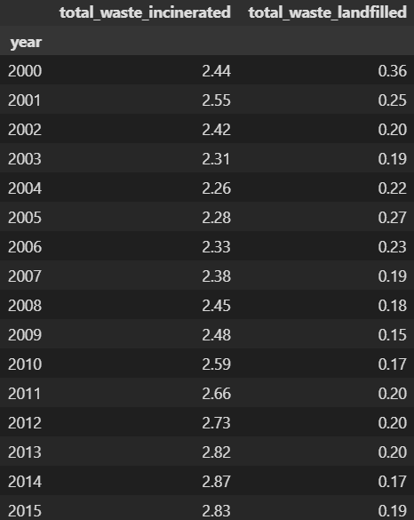

Concatenate Datasets 4 & 5
As both datasets 4 & 5 are related to Waste Disposal, we will concatenate them together
Final Dataset:
Save to New File:

Slide 27
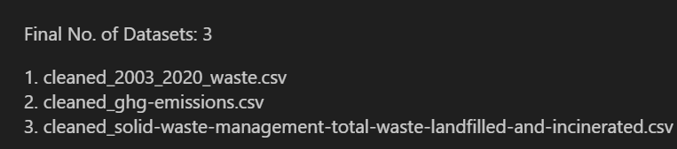
Final Datasets

Slide 28
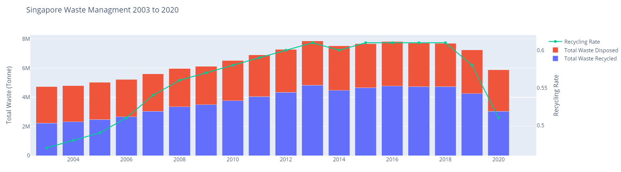
Graph 1: Total Singapore Waste 2003 to 2020
There is generally an increase in the total waste generated due to rapid urbanisation. But we do see a drop in 2019 when COVID-19 first started.
The recycling rate also increases over the years, showing great efforts by the government to raise awareness about the importance of recycling, however we do see a drop in 2019 & 2020, when COVID-19 started.
Notes:
Let’s first look at Singapore Waste Statistics & How Singapore is managing its waste

Slide 29
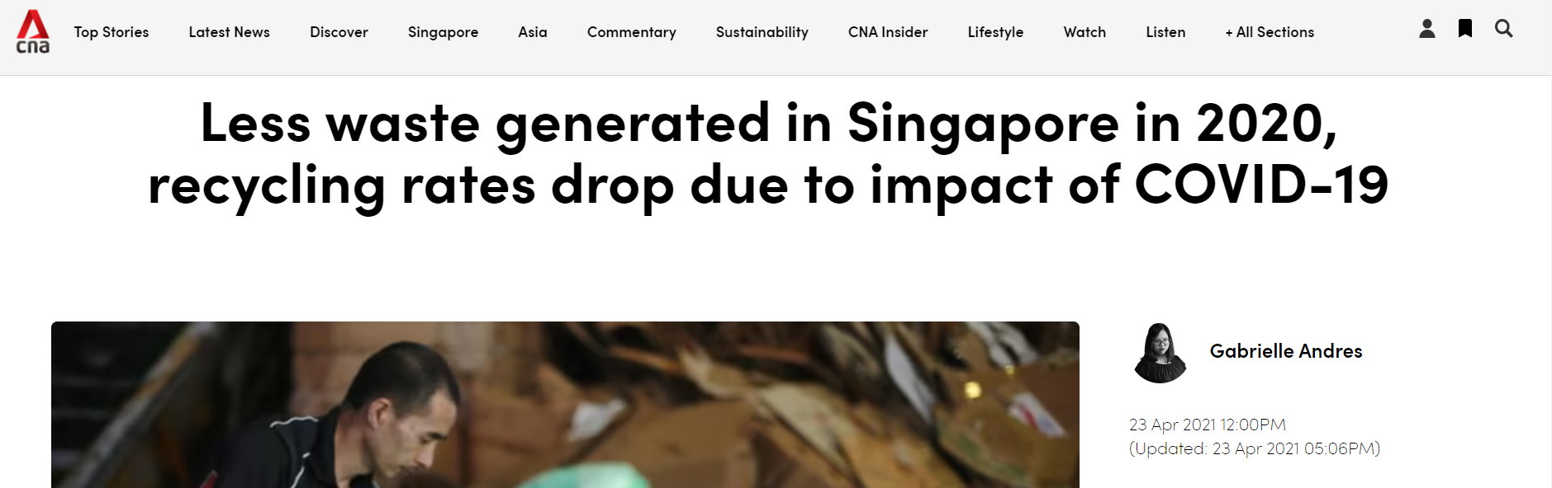
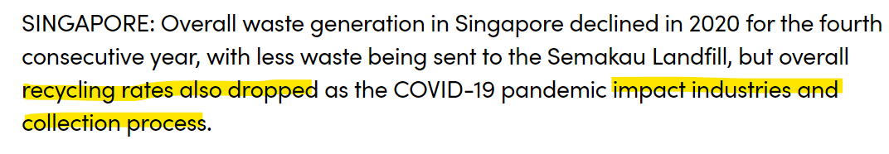
According to CNA:
Waste Collection Process were either halted or delayed due to the ‘circuit breaker’ which decreased the recycling rates

Slide 30
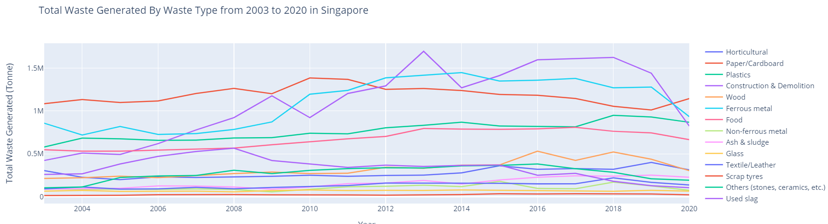
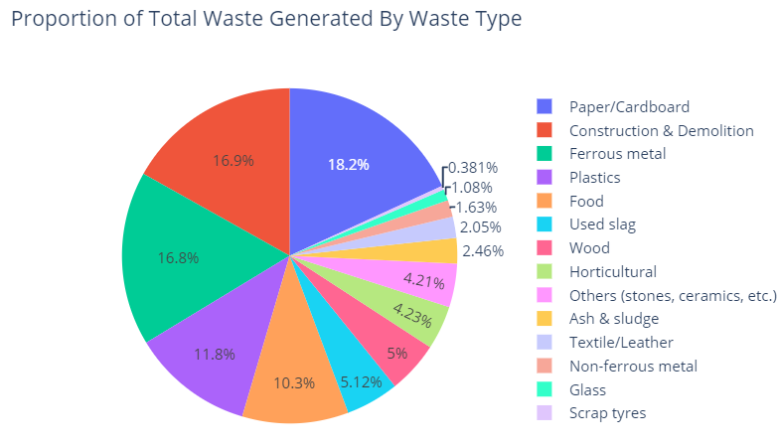
Graph 2/3: Total Waste Generated by Waste Type 2003 to 2020
There are 3 prominent Waste Types generating the most waste which are 'Paper/Cardboard', 'Construction & Demolition' & 'Ferrous Metal',
However, there is a big drop in "Construction & Demolition" & "Ferrous Metal" due to the COVID-19 pandemic as construction work have to be paused & delayed due to the ‘Circuit Breaker” & “Health Measures”
Notes:
Next, we’ll visualise how the different waste types are contributing to waste in Singapore

Slide 31

Graph 4: Recycling Rate by Waste Type
Generally, the recycling rate is high or increasing for most waste types, showing great effort in Singapore to promote recycling to help the environment
The waste types with the top 3 recycling rates are "Construction", "Ferrous Metal" & "Used Slag"

Slide 32


Graph 4/5: Total Waste Disposed & Greenhouse Gas Emissions From Waste
Moreover, Singapore is closely managing the disposal of waste as it emits the greenhouse gases CH4 & N2O , which warms the earth.
Insights:
Over the years, there is a gentle increase in the total amount of waste disposed. Most of the waste is incinerated, while the rest is landfilled to control the burning of waste to control the air quality & emissions of air pollutants like CO2, which contributes to climate change
Notes:
Next, we’ll visualise Singapore’s Disposal of Waste & Greenhouse Gas Emissions From it

Slide 33

Moreover, according to World Economic Forum:
The waste sector is responsible for 20% of global methane emissions. And these methane emissions have more than 80 times the warming power of CO2, hence it is critical to monitor how waste is disposed
Thus, next we will be fitting a simple linear model to see if we can predict CH4 emissions based on the total waste disposed

Slide 34


Graph 6: Simple Linear Model for CH4 Emissions vs Total Waste Disposed
There's a R*2 value of 0.683, indicating that:
Linear model is a moderate fit
There’s moderate correlation between Total Waste Disposed & CH4 Emissions
There is a positive correlation between Total Waste Disposed & CH4 emissions from it
Fitting Linear Model
Notes:
As we need a sample size of at least 20, we will be utilising the total waste disposed from dataset 1 & 3
Graph 7: A JointPlot to show the correlation between Total Waste Disposed & CH4 emissions
Along the axis, we can also see the distribution for each variable across the years 2003 to 2019

Slide 35


Graph 7: Total Waste Sent to Semakau Landfill
Insights:
Big drop of 30% in waste sent to Semakau Landfill from 2000 to 2001. After this big drop, the amount of waste sent continuously decreases & remains low
This is because, the Semakau Landfill will run out of space by 2035 at the current rate of waste growth
Hence, the government is controlling the amount of waste sent by gradually decreasing the rate, in order to have increase the lifespan of Semakau by 5 to 10 more years
According to Zero Waste Nation.gov:

Slide 36

Conclusion
Waste Management plays a big part in mitigating climate change & all the scarce materials on earth by recycling & being responsible about our consumption of resources
By ensuring responsible consumption of resources, it reduces greenhouse gases emissions from waste, which contributes to climate change & the warming of earth’s surface
It is also especially important in Singapore where there is limited land & the only landfill, Semakau, we have is slowly running low on its lifespan over the next few decades
World Health Organisation Sustainable Goal 12:

Slide 37
References
https://www.channelnewsasia.com/singapore/less-waste-generated-singapore-recycling-rates-drop-239601
https://www.health.ny.gov/environmental/outdoors/air/landfill_gas.htm#:~:text=Methane%20and%20carbon%20dioxide%20make,bacteria%20break%20down%20organic%20waste.
https://www.weforum.org/agenda/2022/11/waste-emissions-methane-cities/#:~:text=The%20waste%20sector%20is%20responsible,for%20Incinerator%20Alternatives%20(GAIA).
https://www.towardszerowaste.gov.sg/zero-waste-nation/#:~:text=Semakau%20Landfill%20is%20Singapore's%20one,out%20of%20space%20by%202035.
Datasets:
https://www.kaggle.com/datasets/mahaanand/singapore-waster-mgmt?select=2003_2017_waste.csv
https://www.kaggle.com/datasets/mahaanand/singapore-waster-mgmt?select=2018_2020_waste.csv
https://www.climatewatchdata.org/ghg-emissions?breakBy=gas&end_year=2019&gases=all-ghg&regions=SGP&sectors=waste&start_year=1990
https://data.gov.sg/dataset/solid-waste-management-total-waste-incinerated-annual?view_id=882ae208-bd25-4b99-8cc9-a3b7b24d063a&resource_id=e4c8461f-e7de-4fc3-ad25-cf068ae09509
https://data.gov.sg/dataset/solid-waste-management-total-waste-landfilled-annual?view_id=c89734bc-5081-4730-be0e-83f2f59ab735&resource_id=81292d12-57a5-4e76-a65b-effacc6806b7

